Slide 1

Modeling Uncertainty in the Earth Sciences: Introduction
Modeling Uncertainty in the Earth Sciences
Jef Caers
Stanford University

Slide 2
What is this book about?
Modeling uncertainty in the Earth sciences

Slide 3
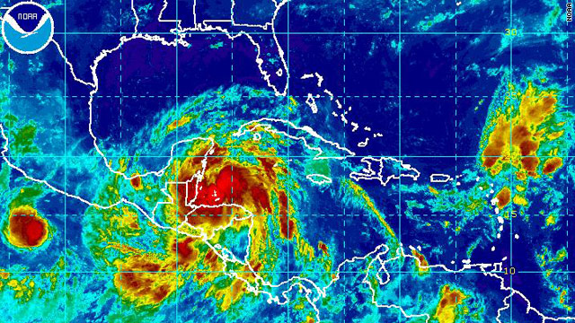
June 26, 2010: CNN headlines
“Tropical storm plus oil slick equal uncertainty”
BP DeepHorizon spill
?
Decision question: “Will BP evacuate the clean-up crew knowing that should evacuation requires at least 3 days, with the consequence of more oil spilling in the golf from the deep-water well, or, will BP leave the crew, possibly exposing them to tropical storm Alex, which may or may not become a hurricane?” A simple question: what is the best decision in this case?

Slide 4
Case study
Decision to be made:
relocation of farms, industry, city development etc
to protect groundwater

Slide 5
Context
Danish Government’s 10-point program (1994)
Pesticides dangerous to health and environment shall be removed from the market
Pesticide tax - the consumption of pesticides shall be halved
Nitrate pollution shall be halved before 2000
Organic farming shall be encouraged
Protection of areas of special interest for drinking water
New Soil Contamination Act - waste deposits shall be cleaned up
Increased afforestation and restoration of nature to protect groundwater
Strengthening of the EU achievements
Increased control of groundwater and drinking water quality
Dialogue with the farmers and their organisations
Source: http://www.geus.dk/program-areas/water/denmark/case_groundwaterprotection_print.pdf

Slide 6
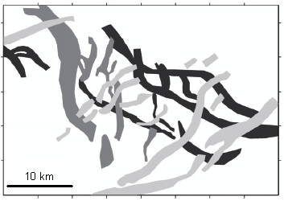
Decision making under uncertainty
Groundwater flow depends on many factors
Regional flow
Geological heterogeneity of the subsurface
Pumping conditions / well locations
A
B
A
B

Slide 7
Decision making
Decision making requires a conscious irrevocable allocation of resources to achieve desired objectives
Objectives may be conflicting
Not all objectives can be easily put in numbers
Requires a specification of “risk” and “value”
Presence of uncertainty
A good decision does not always lead to a good outcome

Slide 8
Why is there uncertainty?
Uncertainty is due to the lack of knowledge to exhaustively and deterministically determine all aspects of the studied phenomenon
In this case: geological understanding will not be able to reconstruct perfectly the geological processes that took place, because either:
We do not fully understand all or some of the geological processes creating valleys (global uncertainty)
Even if that is the case, we do not have enough information to uniquely constrain these processes to know where glacial valleys were created (local uncertainty)

Slide 9
Data collection

Slide 10
Sources of uncertainty
Measurement error
Interpretation and processing of raw measurements
Interpretation of the geological setting from data
Spatial uncertainty
Uncertainty on the physical laws governing flow

Slide 11
Elements critical to modeling uncertainty
Decision making context
Modeling uncertainty always requires a context
Geological heterogeneity / spatio-temporal variation
Establish understanding of the medium you are modeling
Data collection and value (or lack thereof) of information
Data may constrain models of uncertainty and may improve decisions

Slide 12
Nature of modeling uncertainty in the Earth Sciences
Needs to be application tailored
Several sources of uncertainty
Measurements and their interpretation
Geological setting
Spatial variation
Response uncertainty
Uncertainty assessment is subjective
Dealing with a high-dimensional / large problem
Mathematical challenges
Memory demanding
CPU demanding
Need to deal with several data sources

Slide 13
Aim of this book
Modeling uncertainty in the Earth sciences

Slide 14
Aim
To be practical
What matters?
No theory, example-driven
To discuss principles, concept and tools of modeling uncertainty
To discuss the practice of such modeling with actual software
To teach the why/what not exactly how it works

Slide 15
Book content
Modeling uncertainty in the Earth sciences

Slide 16
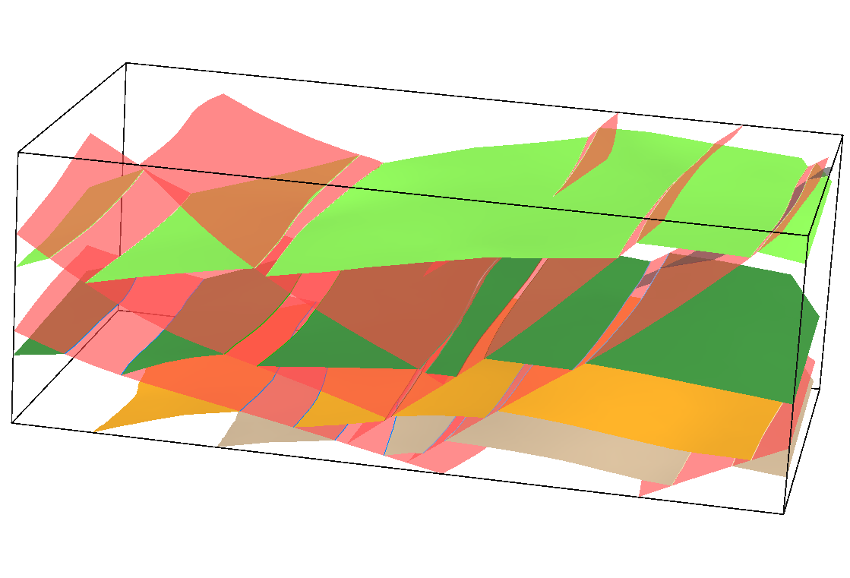
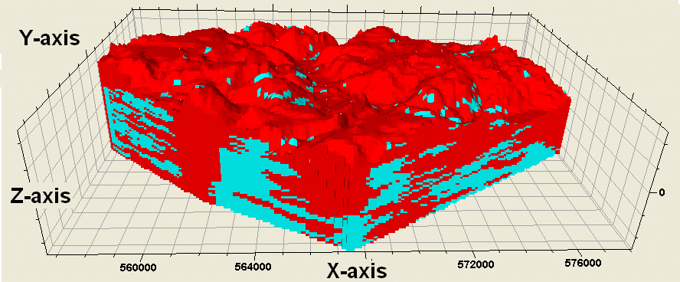
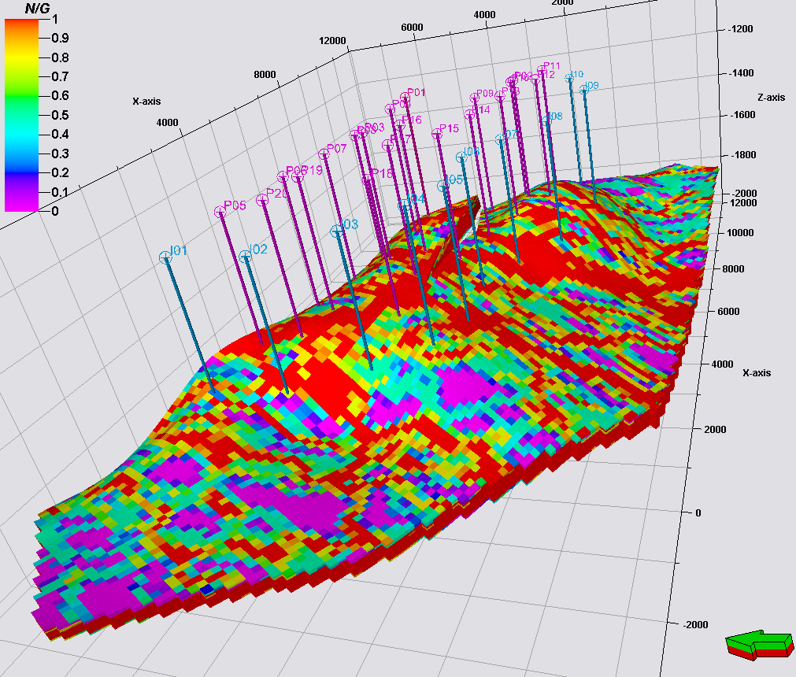
Modeling
To understand modeling uncertainty we need to understand how one builds a single model
An Earth model has
A structural component
Properties filling these structures
Data constraining what is being built
Model of Glacial Valley

Slide 17
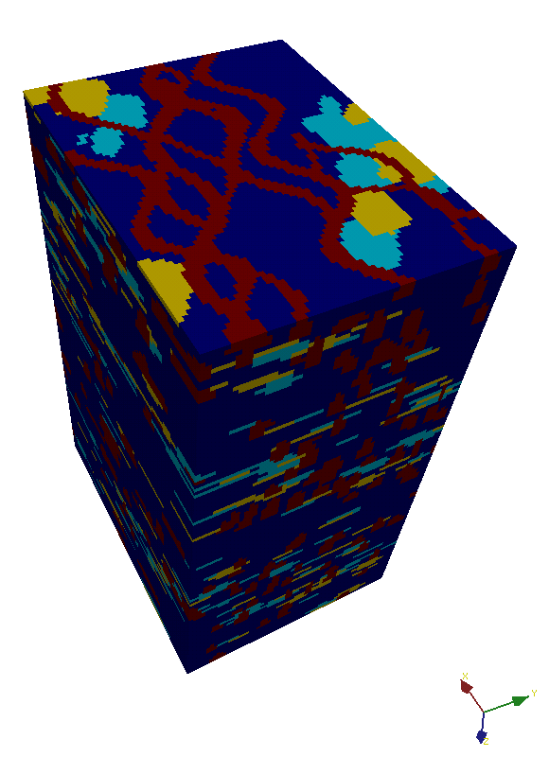
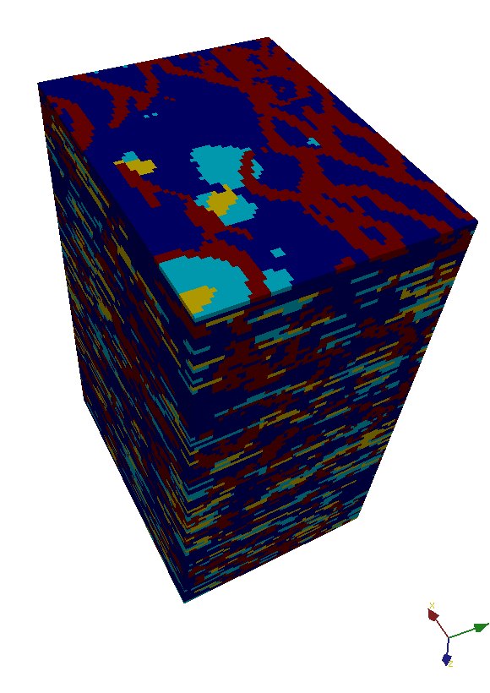
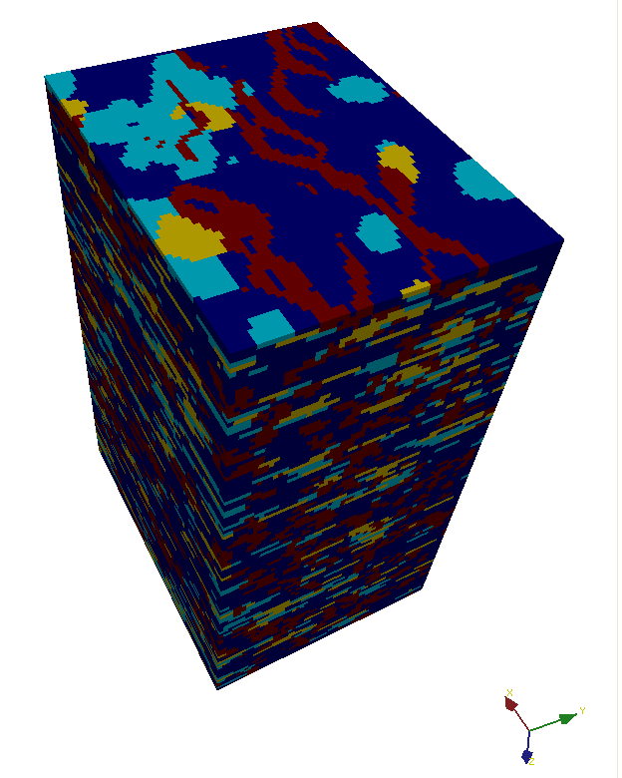
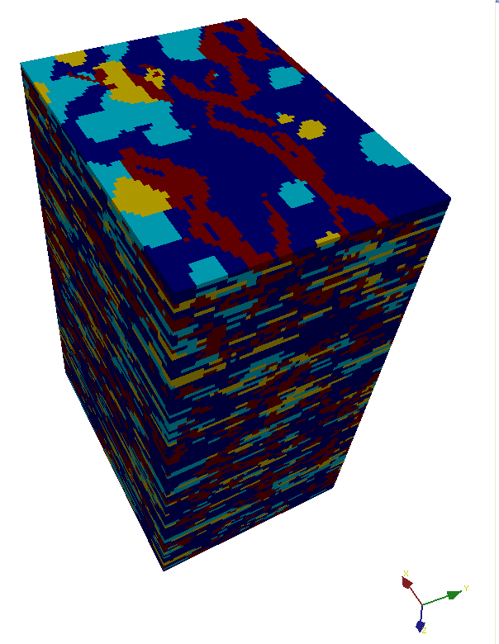
Modeling uncertainty
Uncertainty of Earth models will be represented by building several alternative models
Teach the concept of randomization and how this leads to the constructing alternative Earth models

Slide 18
Engineering the Earth under uncertainty
Decision analysis for including such uncertainty in making decision about engineering operations
Figure out what matters for such decision

Slide 19
Value of information
To determine the value of gathering data prior to actually gathering the data, this value will depend on
The particular decision problem at hand
The uncertainty prior to gathering the data
The physics underlying the measurement
The reliability of the measurement device in resolving spatial variation or key geological drivers

Slide 20
Book content
Decision making under uncertainty
Spatial continuity and uncertainty
Structural modeling and uncertainty
Response uncertainty
Value of information

